Slide 1


AI and ML to Stock Movement Analysis
By Vanban Wu, Ph.D.
Global IoT Technologies LLC

Slide 2
Section 1: Candlesticks Fundamentals
Section 2: ML to Stocks Movement Analysis
Section 3: AI to Stocks Trading
Contents

Slide 3
A
Candlesticks Fundamentals

Slide 4
General Form of Candlestick (Stocks Movement)
The general form of a candlestick is composed of a body, and two wicks at each end of the body.
High
High
Open
Close
Bearish
Body
Bullish
Close
Open
Low

Slide 5
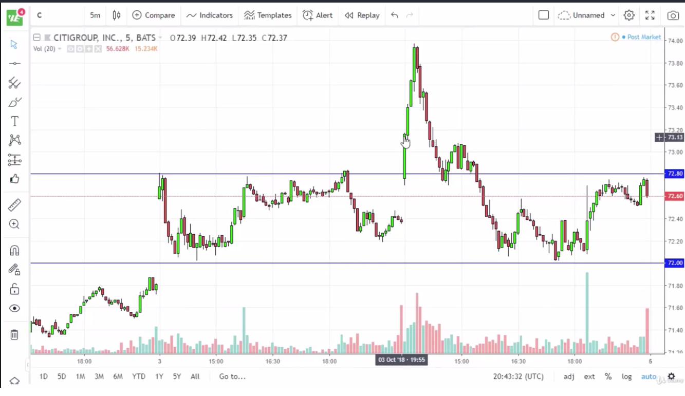
Support & Resistance Levels
Resistance
Support

Slide 6
Types of Candlesticks used in Single Candlesticks Trading Strategies
Belt Hold
Hammer
Hanging Man
Reverse Hammer
Shooting Star
Marubozu
Doji
Spinning Top

Slide 7
Types of Candlesticks Patterns
Hammer
Reverse Hammer
Belt Hold
Hanging Man
Shooting Star

Slide 8
How to Classify this Specific Group of Patterns
They are not Marubozu pattern
One and only one wick missing from the body of the pattern
For a bullish candlestick, the top wick is missing (High == Close)
For a bullish candlestick, the bottom wick is missing (Low == Open)
For a bearish candlestick, the top wick is missing (High == Open)
For a bearish candlestick, the bottom wick is missing (Low == Open)
Note: Marubozu pattern: (High – Low) == Abs(Open – Close)
Marubozu
Pattern

Slide 9
Other Parameters used in Moving Averages Analysis
Exponential Moving Average (EMA): EMA(5), EMA(10), EMA(20), EMA(30), EMA(50), EMA(100), EMA(200)
Simple Moving Average (SMA): SMA(5), SMA(10), SMA(20), SMA(30), SMA(50), SMA(100), SMA(200)
Movement Average Convergence Divergence (MACD)

Slide 10
B
ML to Stocks Movement Analysis

Slide 11
Features in Dataset
Date
High
Low
Open
Close
Volume
Adjusted Close
MACD
Signal
Histogram
SMA_60
SMA_180
Marking

Slide 12
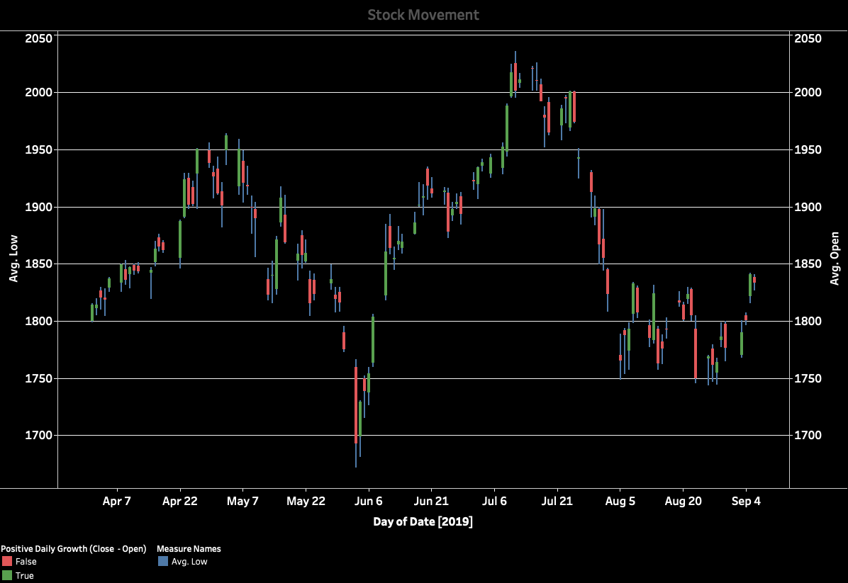
Data Visualization of the Dataset (Stock Movement)

Slide 13
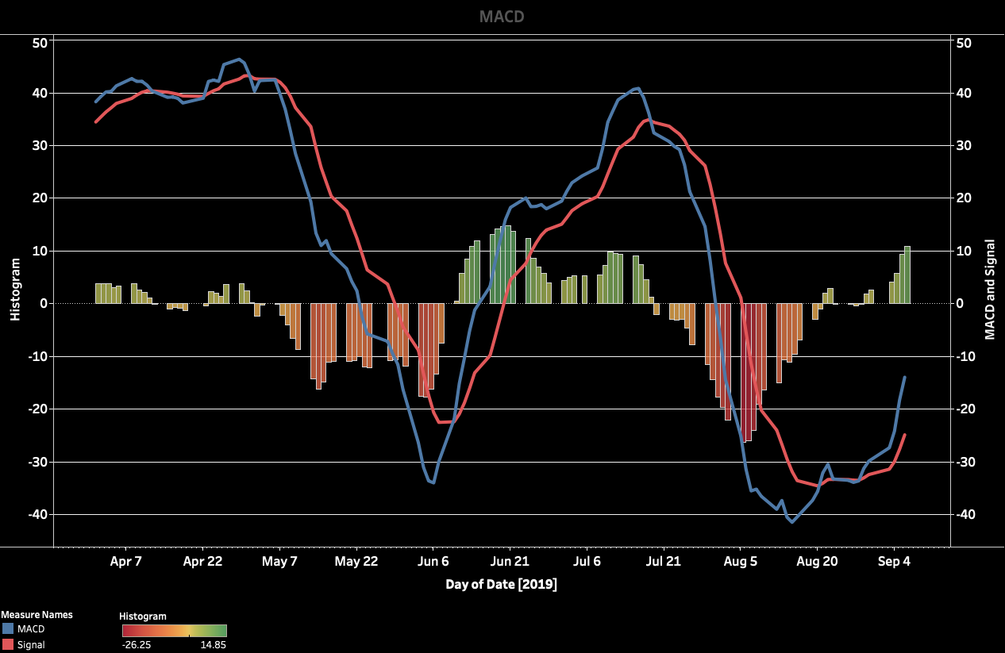
Data Visualization of the Dataset (MACD)

Slide 14
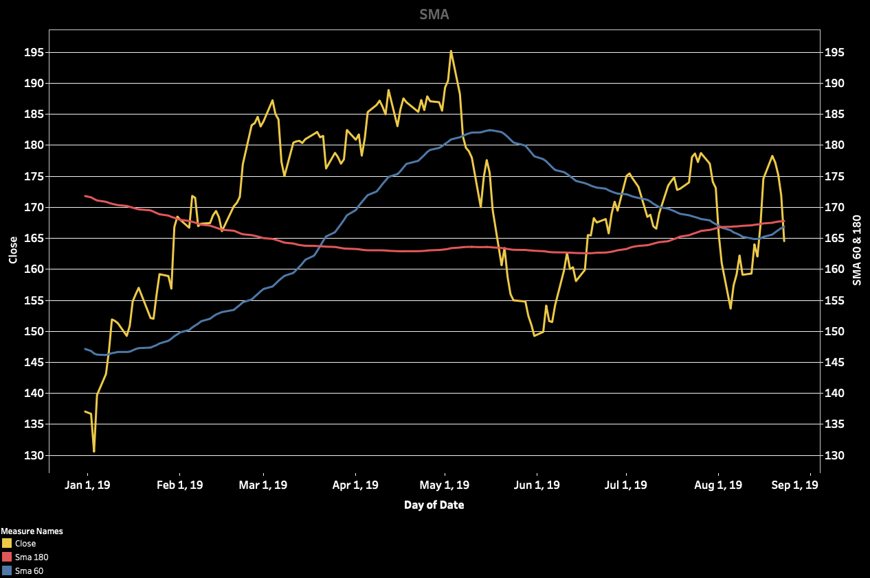
Data Visualization of the Dataset (SMA)

Slide 15
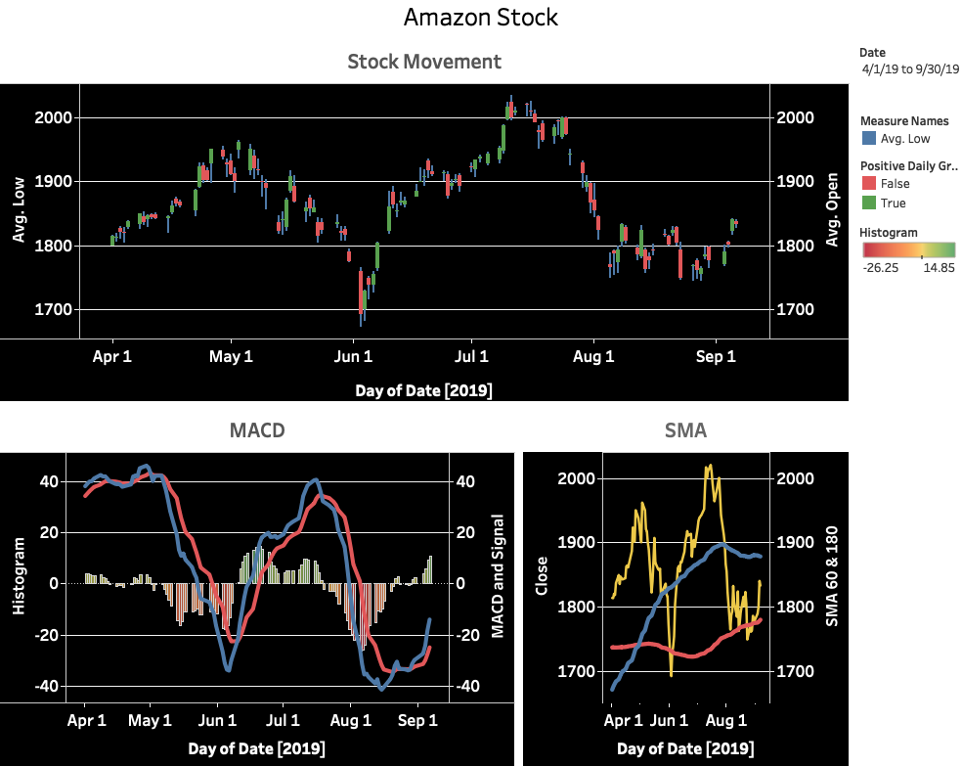
Data Visualization of the Dataset (Diagram)

Slide 16
Machine Learning Models
Objective: To use ML to identify all specified patterns (Belt Hold, Hammer, Hanging Man, Reverse Hammer, Shooting Star)
ML Classification Models:
Logistic Regression
K-Nearest Neighbor
Support Vector Machine
Naïve Bayes
Decision Tree
Random Forest
Deep Learning (Artificial Neural Network – ANN)

Slide 17
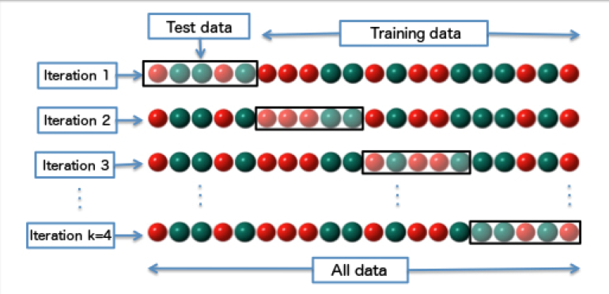
K-Fold Cross Validation Method
Use to evaluate how accurate a classification model perform in practice by using different partition in each prediction iteration
Note: Picture taken from Wikipedia

Slide 18

Accuracy Measures
Dataset Size: 2,257
Marking Size: 90
Training Set Size: 1,512
Test Set Size: 745

Slide 19

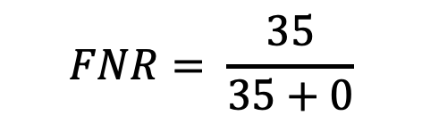
False Negative Rate
False Negative Rate (FNR) or Type II Error Rate:
$$FNR= \frac{35}{35+0}$$

Slide 20
Two Resampling Techniques for Imbalanced Dataset
Over-sampling Technique: By adding more copies of the minority class to the training set.
Under-sampling Technique: By removing some observations of the majority class from the training set.
 | Training Set | Test Set |  |  | Predicted Class
Logistic Regression | 0.4979 | 0.9476 |  |  | 0 | 1
 |  |  | Actual | 0 | 706 | 4 | FNR
 |  |  | Class | 1 | 35 | 0 | 100.00%
K-Nearest Neighbor | Training Set | Test Set |  |  | Predicted Class
 | 0.9704 | 0.8657 |  |  | 0 | 1
 |  |  | Actual | 0 | 640 | 70 | FNR
 |  |  | Class | 1 | 30 | 5 | 85.71%
Support Vector Machine | Training Set | Test Set |  |  | Predicted Class
 | 0.5175 | 0.2389 |  |  | 0 | 1
 |  |  | Actual | 0 | 152 | 558 | FNR
 |  |  | Class | 1 | 9 | 26 | 25.71%
Naïve Bayer | Training Set | Test Set |  |  | Predicted Class
 | 0.5072 | 0.2469 |  |  | 0 | 1
 |  |  | Actual | 0 | 159 | 551 | FNR
 |  |  | Class | 1 | 10 | 25 | 28.57%
Decision Tree | Training Set | Test Set |  |  | Predicted Class
 | 1.0000 | 0.9234 |  |  | 0 | 1
 |  |  | Actual | 0 | 688 | 22 | FNR
 |  |  | Class | 1 | 35 | 0 | 100.00%
Random Forest | Training Set | Test Set |  |  | Predicted Class
 | 1.0000 | 0.9449 |  |  | 0 | 1
 |  |  | Actual | 0 | 710 | 0 | FNR
 |  |  | Class | 1 | 35 | 0 | 100.00%
Deep Learning | Training Set | Test Set |  |  | Predicted Class
 | 0.7234 | 0.6456 |  |  | 0 | 1
 |  |  | Actual | 0 | 464 | 246 | FNR
 |  |  | Class | 1 | 18 | 17 | 51.43%
 | Training Set | Test Set |  |  | Predicted Class
Logistic Regression | 0.5000 | 0.557 |  |  | 0 | 1
 |  |  | Actual | 0 | 398 | 312 | FNR
 |  |  | Class | 1 | 18 | 17 | 51.43%
K-Nearest Neighbor | Training Set | Test Set |  |  | Predicted Class
 | 0.6636 | 0.5812 |  |  | 0 | 1
 |  |  | Actual | 0 | 417 | 293 | FNR
 |  |  | Class | 1 | 19 | 16 | 54.29%
Support Vector Machine | Training Set | Test Set |  |  | Predicted Class
 | 0.5454 | 0.2617 |  |  | 0 | 1
 |  |  | Actual | 0 | 171 | 539 | FNR
 |  |  | Class | 1 | 11 | 24 | 31.43%
Naïve Bayer | Training Set | Test Set |  |  | Predicted Class
 | 0.5545 | 0.2684 |  |  | 0 | 1
 |  |  | Actual | 0 | 175 | 535 | FNR
 |  |  | Class | 1 | 10 | 25 | 28.57%
Decision Tree | Training Set | Test Set |  |  | Predicted Class
 | 1.0000 | 0.5906 |  |  | 0 | 1
 |  |  | Actual | 0 | 427 | 283 | FNR
 |  |  | Class | 1 | 22 | 13 | 62.86%
Random Forest | Training Set | Test Set |  |  | Predicted Class
 | 0.9545 | 0.6174 |  |  | 0 | 1
 |  |  | Actual | 0 | 710 | 0 | FNR
 |  |  | Class | 1 | 35 | 0 | 100.00%
Deep Learning | Training Set | Test Set |  |  | Predicted Class
 | 0.7727 | 0.4953 |  |  | 0 | 1
 |  |  | Actual | 0 | 346 | 364 | FNR
 |  |  | Class | 1 | 12 | 23 | 34.29%

Slide 21
C
AI to Stocks Trading

Slide 22
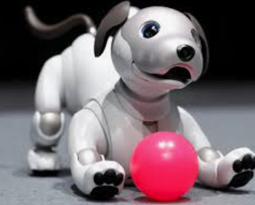
Work in Progress (tbc) …

